Slide 1
Expanding Kairos
Starting New Locations
Presenters | Don Neff – Florida TaJuana Jackson-Williams – Georgia Walter Straham – Georgia

Slide 2







The Pre-Heat
(Devotion and Overview)
The Secret Sauce, Rising Agents & Kitchen Hazards
(Focus on Funding & Execution)
  Following the Cookbook & Prepping the Kitchen
  (Focus on Leadership & Policy)
Plating it with Excellence
(Summary)
Prepping the Three-Layer Masterpiece
(Focus on Programs & Institutions)
The Tasting Room
(Questions & Answers)
The Pre-Heat
Devotion and Overview

Slide 3

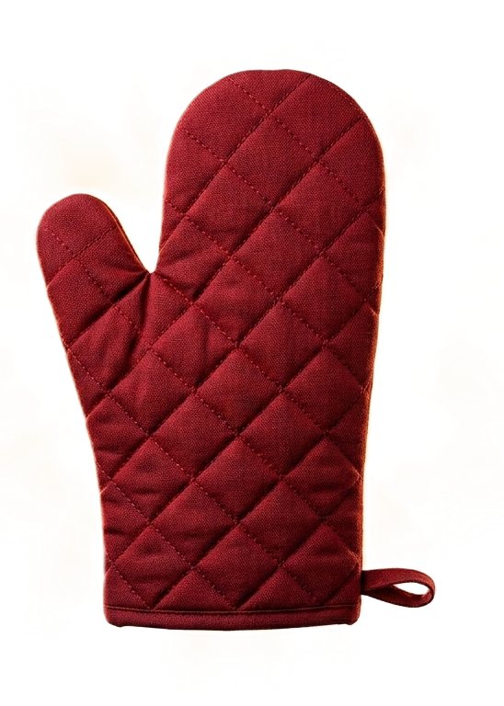
The Pre-Heat
(Devotion and Overview)

Slide 4
^{1 Chronicles 4:9-10}
⁹ There was a man named Jabez who was more honorable than any of his brothers. His mother named him Jabez^{[a]} because his birth had been so painful. ¹⁰ He was the one who prayed to the God of Israel, “Oh, that you would bless me and expand my territory! Please be with me in all that I do and keep me from all trouble and pain!” And God granted him his request. NLT

Slide 5
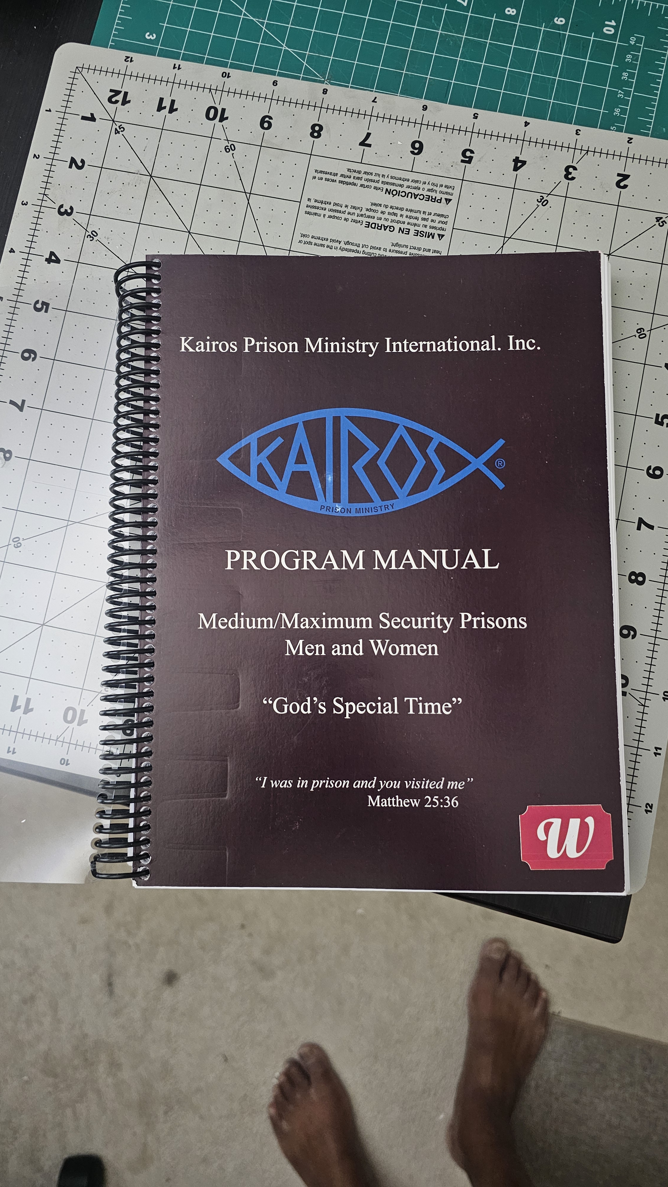

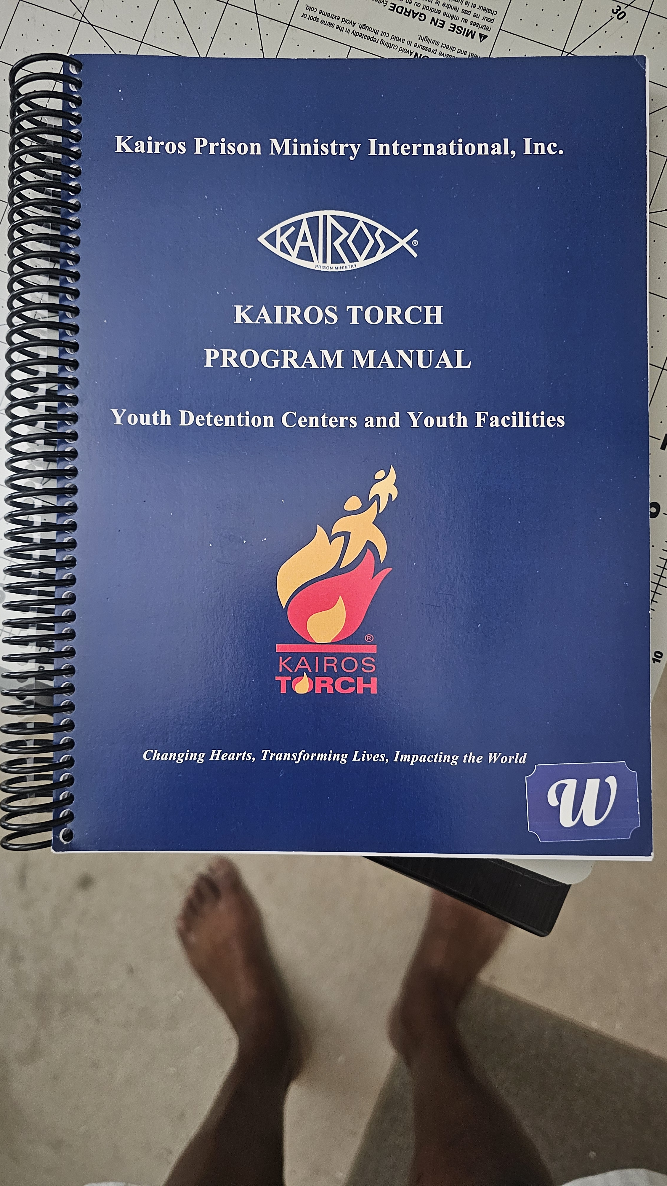
Following the Cookbook & Prepping the Kitchen
(Focus on Leadership & Policy)

Slide 6
Leadership and Policy
Following the Cookbook & Prepping the Kitchen
  Core Ingredient - Kairos Manuals
  Avoiding Rogue Roles
  Spiritual Readiness in Ministry
The Core Ingredient – Understanding the absolute necessity of our Kairos Manuals, established guidelines and system safety boundaries.

Slide 7
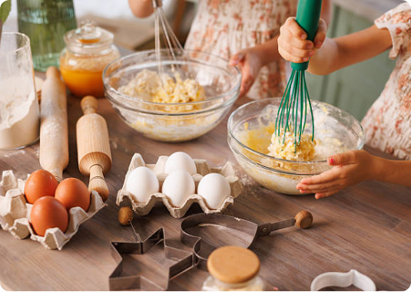
Staying Within the Riverbanks
In ministry, just as in master-class baking, strict adherence to the recipe dictates success or total failure.
The Baking Analogy: If a recipe calls for baking powder and you swap in cornstarch because they look identical, the entire cake is instantly ruined.
Riverbank Boundaries: The Kairos "Riverbanks" represent our safe operating limits. They keep us standardized, aligned with prison protocols, and legally sound.
Predictable Outcomes: True servant leaders/volunteers do not experiment with established structural recipes.

Slide 8
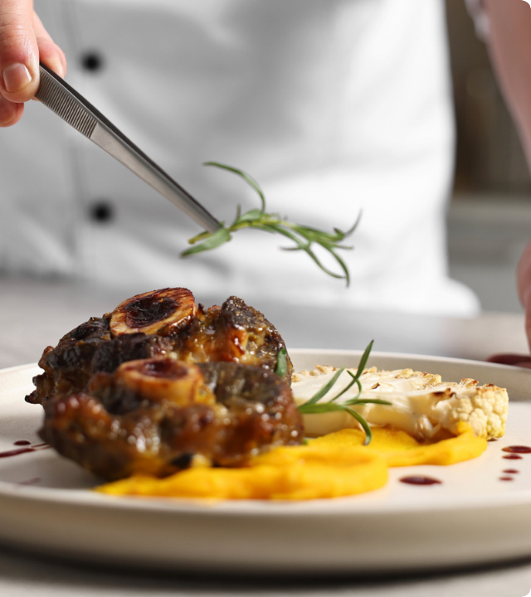
The Policy Constraint
Absolute Compliance is Key
When scaling and executing Kairos expansions, our structural procedures are completely non-negotiable.
No Improvisation: Every operational step has been carefully vetted. Adhering closely to the cookbook guarantees kitchen safety, systemic consistency, and solid compliance.

Slide 9
The Spoiled Ingredient
The "Lone Ranger" Volunteer
  These are individuals who choose to operate independently from the team, bringing unauthorized ingredients into the recipe, or completely ignoring safe instructions.
  They act based on personal agendas rather than collective operational discipline.
Spoiling the Entire Batch
  Just like adding one spoiled ingredient into an otherwise pristine mix, a single volunteer disregarding boundaries can compromise prison security clearances, ruin volunteer relations, and completely disrupt spiritual safety.

Slide 10




Core Leadership Readiness
Christ-Centered
Servant Leaders
Obedience & Honor
Ensuring that every kitchen team member is anchored spiritually in Christ and operates purely out of genuine faith.
We do not seek "warm bodies" for simple presence. We need active volunteers willing to serve with deep humility.
Willingness to lay down individual ego and personal methods to operate safely within the established Riverbanks.

Slide 11
Preparing for Impact
"We aren't looking for warm bodies to stand at the counter; we need Christ-centered volunteers who practice servant leadership."
Are our hearts prepped?
Are our hearts prepped? Is our kitchen operating inside the riverbanks? Let us align with the master cookbook to ensure safety, obedience, and structural success on every single weekend.
Are our hearts prepped? Is our kitchen operating inside the riverbanks?

Slide 12




Prepping the Three-Layer Masterpiece
(Focus on Programs & Institutions)

Slide 13

Prepping the Three-Layer Masterpiece
Kairos Inside
What facility are we targeting for development?
Need a key person.
What does the volunteer base look like?
Establish an Advisory Council (mixer).

Slide 14
Prepping the Three-Layer Masterpiece

Slide 15
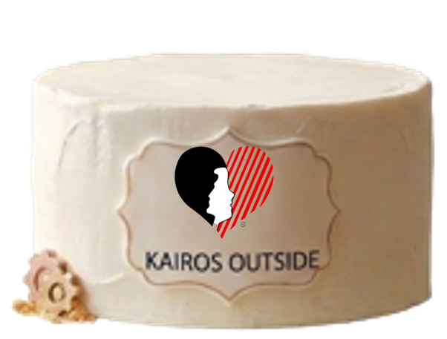
Prepping the Three-Layer Masterpiece
Kairos Outside
Before the weekend
During the weekend
After the weekend
Ongoing Care
“The overall goal is to help every woman feel seen, supported, connected, and encouraged.”

Slide 16
Prepping the Three-Layer Masterpiece

Slide 17
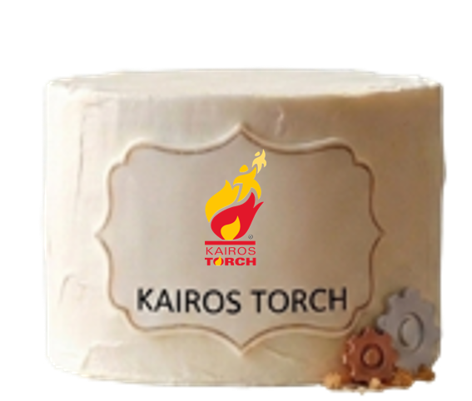
Prepping the Three-Layer Masterpiece
Kairos Torch – High-Energy Fusion
Institutional Base
  Explain how the program will act as a seamless extension of the facility team
Releasing the Masks
  Share how the program (safe heat) will melt the defensive shells
Long-Term Bake
  Empowering youth to become cycle-breakers through mentoring
  Mend a broken family and create a safer environment

Slide 18
Prepping the Three-Layer Masterpiece

Slide 19
Prepping the Three-Layer Masterpiece
Kitchen Tool
The Advisory Council (The Stand Mixer).
  You cannot mix these three heavy layers by hand. You need a functioning Advisory Council infrastructure for each layer to hold the weight.

Slide 20

The Secret Sauce, Rising Agents & Kitchen Hazards
(Focus on Funding & Execution)

Slide 21

The Secret Sauce, Rising Agents & Kitchen Hazards
Volunteers Are The Yeast
Small acts of service create lasting transformation.
Every volunteer has a unique and essential role.
Prayer, love, and service help the ministry grow.
Volunteers create an environment where God changes lives.
Without volunteers, the ministry would fall flat.
Together, we help Kairos rise and fulfill its mission.

Slide 22
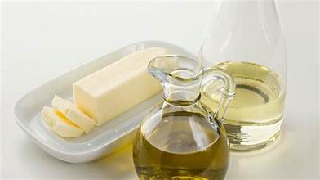
The Secret Sauce, Rising Agents & Kitchen Hazards
Fundraising Is The Oil/Butter
Oil and butter nourish and enrich—fundraising sustains the ministry.
Provides the resources needed for Kairos weekends and reunions.
Supports meals, supplies, Bibles, and ministry materials.
Every donation, large or small, makes a meaningful impact.
Financial support removes barriers so lives can be transformed.
Fundraising is an investment in changed hearts and renewed hope.
Good stewardship honors every gift entrusted to the ministry.

Slide 23

The Secret Sauce, Rising Agents & Kitchen Hazards
Kitchen Hazards
Facility Administration and Staff
Space limitations
Certifying volunteers through State Dept of Corrections
Facility goes into lockdown before first weekend
Number of volunteers drop below the number of participants

Slide 24

Plating it with Excellence

Slide 25
Plating the Masterpiece
Following the Cookbook (Kairos Manual and Staying within the Riverbanks)
Quality Ingredients (Christ-center leaders/volunteers)
Multi-tiered Masterpiece (Kairos Inside, Kairos Outside, Kairos Torch)
Stand Mixer (Advisory Council)
Rising Agents (Recruiting and Fundraising)
Hazards (Facility Lockdowns, rule changes, or delays)

Slide 26
The Charge
When we serve this cake to a new community, it must look and taste like Christ's love. Expanding this ministry is hard work, but when done with excellence, it feeds and transforms generations.
Let’s go out and bake with excellence!

Slide 27

The Tasting Room
(Questions and Answers)

Slide 28
Expanding Kairos
Starting New Locations
Presenters | Don Neff – Florida TaJuana Jackson-Williams – Georgia Walter Straham – Georgia

